Slide 1


Slide 2
Multizol-35© Water Shut-off Technology
In Oil & Gas Wells with
Post-treatment Production Stimulation
MULTIZOL-35© - Micellar Microemulsion Fluid
Sławomir Falkowicz, falkowicz@inig.pl
Winicjusz Stanik, stanik@inig.pl

Slide 3
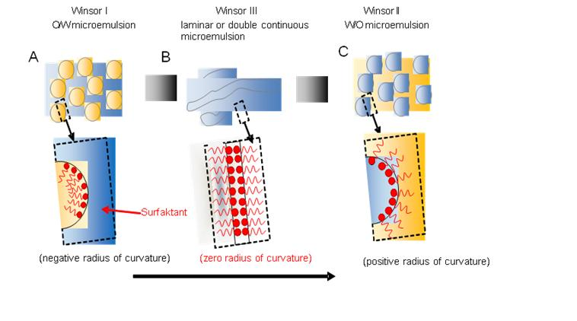
Multizol-35© – Water Shut-Off
Fluid Characteristic
Phase transition mechanism
Activated by brine concentration
Rheologically stable fluid system
Validated on over 80 core flow test
Proved in the field conditions
Irreversible
Phase transition mechanism
Notes:
Add notes

Slide 4
Produced water – a growing problem in Poland and USA
Natural Gas / Water Ratios
Approximately 4 billion m³ of natural gas is extracted annually in Poland.
Using a typical water-gas exponent of 0.1 kg/m³, we calculate water extraction from 4 billion m³ of natural gas = 400 thousand tons of produced water, or about 1-5 m³ of water on average per 1,000 m³ of gas.
In the U.S. the weighted average water-to-gas ratio (WGR) is ≈ 97 barrels of produced water per MMCF (Million Cubic Feet) of natural gas. However, this figure is highly variable depending on the well’s specific location, age and formation.
Oil / Water Ratios
Permian Basin
Average O/W cut approximately 1:4
Individual wells can be < 1:1 or > 1:10
Produced water ≈ 23.5 million bbls / day from oil & gas production. (1)
U.S. On-shore Wells
Average O/W cut ranges from 1:7 to 1:10
Ratio varies with well location and production method. Can be as high as 1:100 or more
Produced Water Disposal & Treatment Cost
Total U.S. disposal costs range from $5–$10 billion per year.
Per barrel disposal costs $0.40 to $1.00
Treatment costs range from $0.10 to $10 per barrel depending on treatment method.
(1) PRODUCED WATER FROM OIL AND GAS DEVELOPMENT
U.S. DOE – June 2024

Slide 5
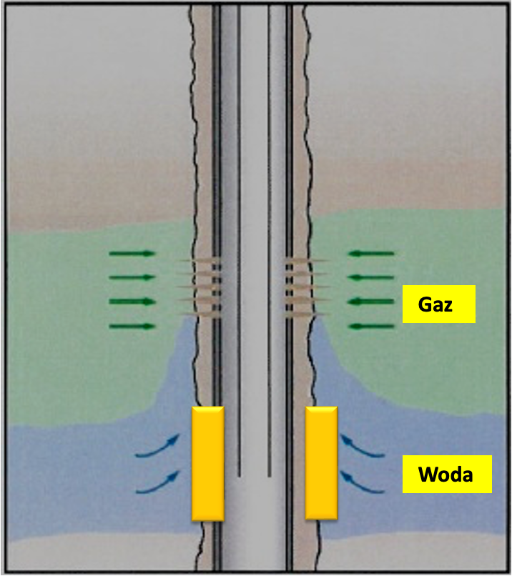
Multizol-35© – Effective System Applications
Insulate water flow from high permeability zones
Mitigate water flow behind the pipe
Block water flow from faults and fractures
Block water incursion from casing leaks
Gas
Water
Water Shutt-Off Schematic
Notes:
Add notes

Slide 6
WSO in wells – state of knowledge
Water Shut- Off procedures in gas/oil wells are divided into:
Mechanical
---------------------------------------------
Injectable (chemical), i.e., injection of a working fluid with sufficient ability to create a filtration barrier in the water formation
To perform the procedure, you need:
A) treatment fluid
B) treatment protocol
Gas
Barier
Barier
Water

Slide 7
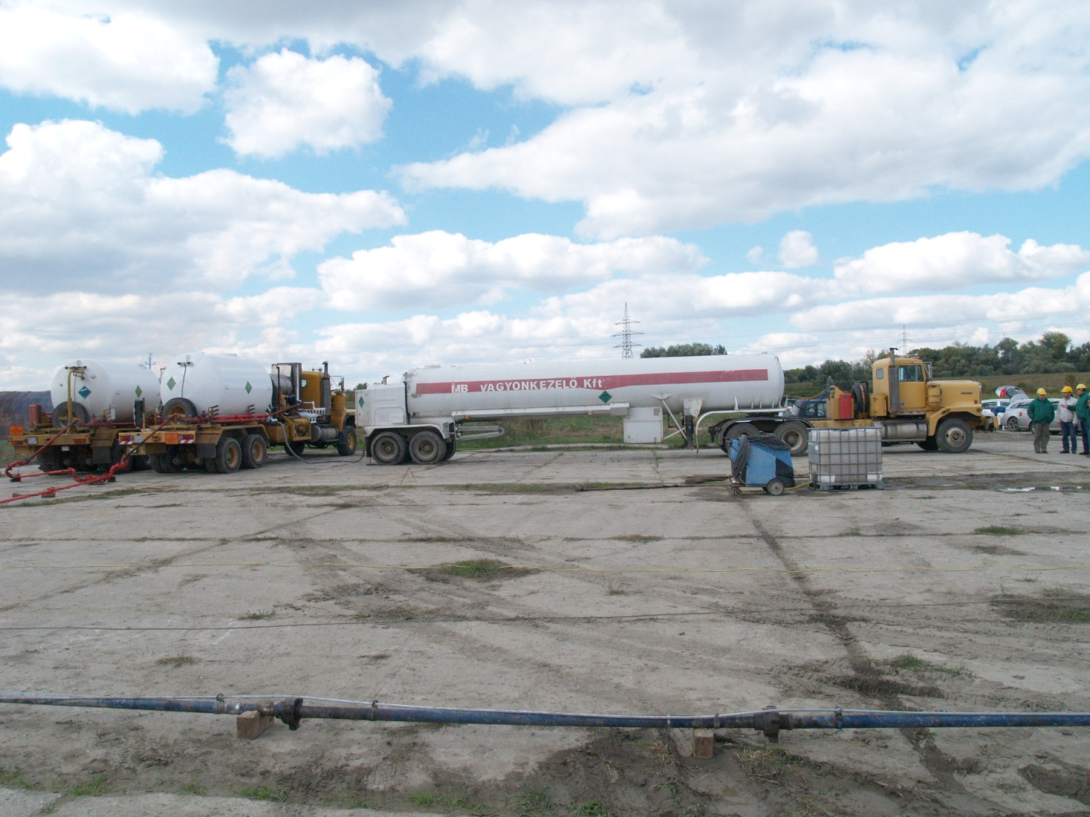
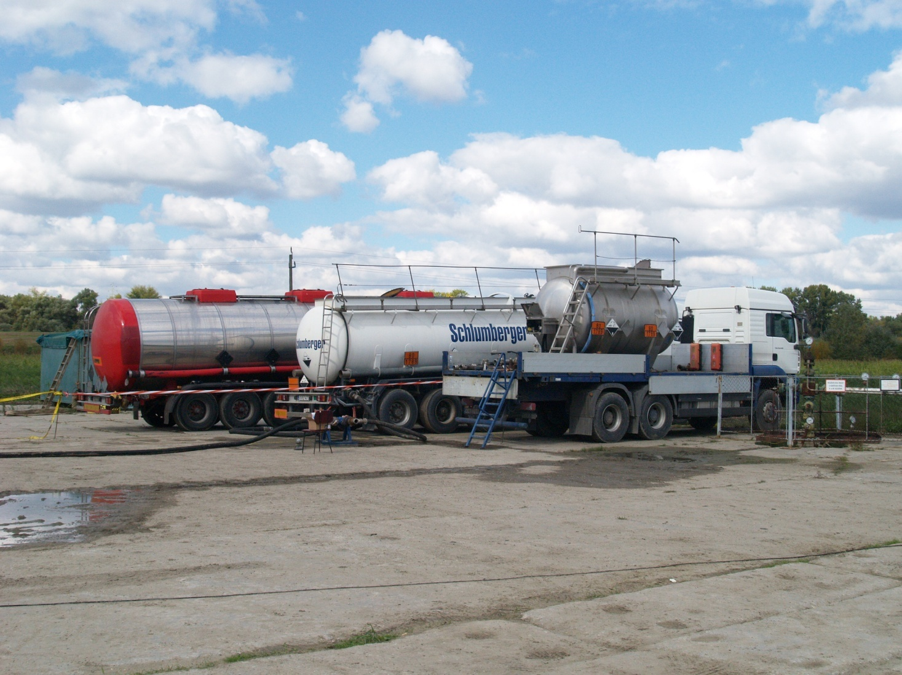
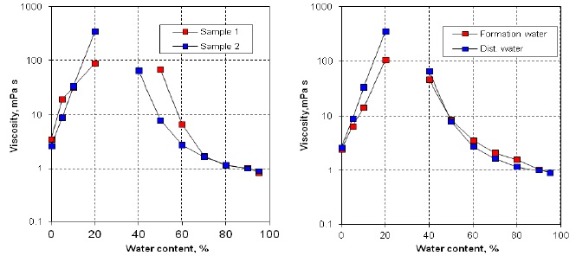
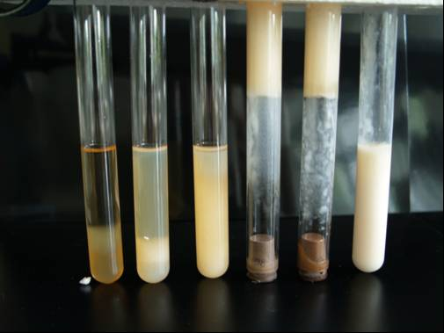
Mechanism of creating a barrier in the formation useing micelar microemulsion treatment fluid
Increase in viscosity of fluid when mixed with water within a specific water content
In Hungary, several successful WSO treatments have been performed using micelar working fluid. However, the Hungarian technology has a serious technological limitation: the water salinity limit is 1.5%.

Slide 8
Multizol-35© – Water Shut-Off
Fluid Characteristics
Phase transition mechanism
Activated by brine concentration
Rheologicaly stable fluid system
Validated on over 80 core flow test
Proved in the field conditions
Reversible
Phase transition mechanism
Notes:
Add notes

Slide 9
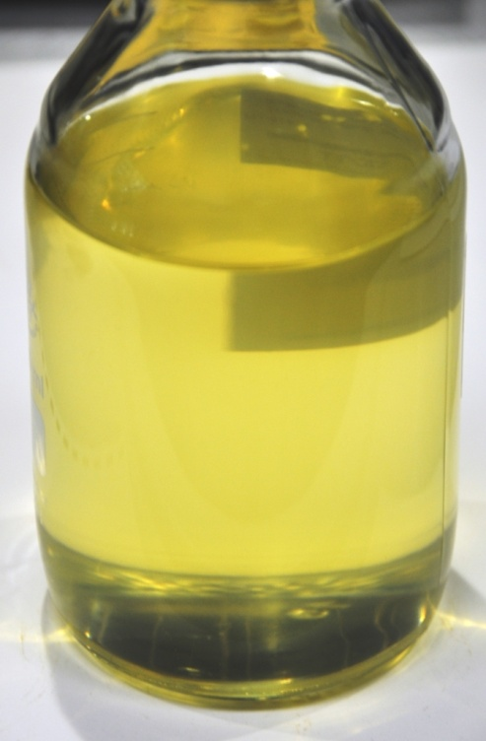
Mutizol treatment fluid
Mutizol© treatment fluid consists of:
environmentally friendly aliphatic solvent 80 %
ester oil
amphiphilic surfactants
Has stable rheological properties and:
density at 15°C approx. 850 kg/m³
dynamic viscosity at 20 °C ≈ 7 mPa*s
flash point > 62°C
.
Dynamic viscosity [mPa·s]
5°C | 10°C | 20°C | 30°C | 40°C | 50°C
10,0 | 9,2 | 7,3 | 6,1 | 5,1 | 4,2
Multizol fluid
15 months after production

Slide 10
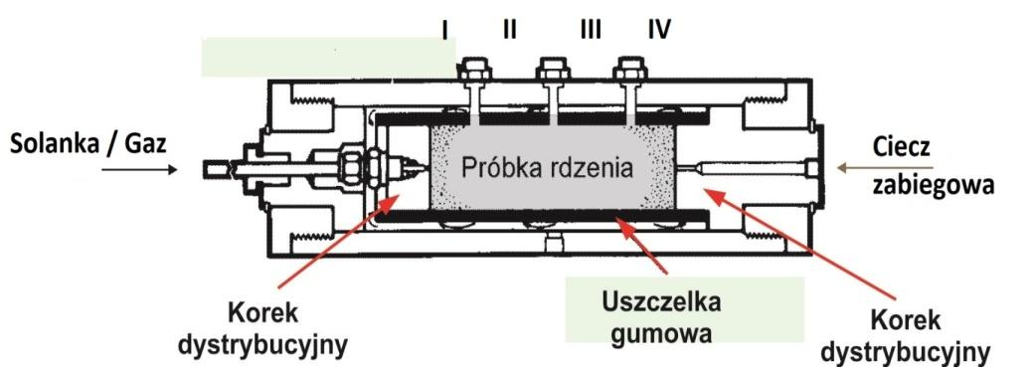
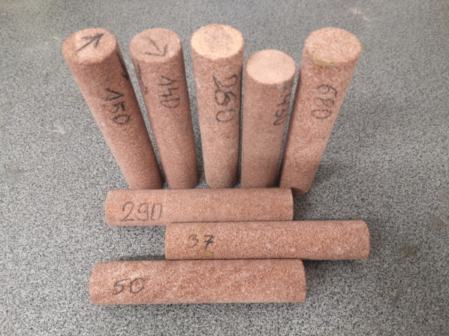
Validation of Multizol effectiveness
      Close to 80 core flow tests were conducted to quantitatively assess the effectiveness of Multizol based on changes in the permeability of rock samples after the working fluid was injected into them under simulated conditions of the near wellbore zone.
  In the case of cores simulating water layers, the loss of permeability ranged from 98% to 100%.
This means the permeability of these samples
to brine was completely eliminated.
In contrast, loss of permeability in samples simulating the gas layer yielded an average value of 14.0%.

Slide 11
Mutizol gel properties
Gel composition | Dynamic viscosity [mPa·s] | Gel composition | Dynamic viscosity [mPa·s]
90% vol. Multizol-35 10% vol. 12% NaCl | 301 | 90% vol. Multizol-35 10% vol. 15% NaCl | 180
85% vol. Multizol-35 15% vol. 12% NaCl | 824 | 85% vol. Multizol-35 15% vol. 15% NaCl | 213
80% vol. Multizol-35 20% vol. 12% NaCl | 1096 | 80% vol. Multizol-35 20% vol. 15% NaCl | 286
75% vol. Multizol-35 25% vol. 12% NaCl | 538 | 75% vol. Multizol-35 25% vol. 15% NaCl | 268
Dynamic viscosity of gels prepared on the basis of Multizol-35 and 12% and 15% NaCl solutions at 30ºC .

Slide 12

WSO treatment scenario using
Multizol treatment fluid
  Cease gas production.
    Clean the perforation zone with a 2% KCl solution.
  After cleaning the perforation, perform an absorption test using a 2% KCl solution. If the absorption test results are positive, proceed to the next stages of work.
Construct an acid bath to remove hydrochloric acid-soluble deposits from the production tubing and perforations.
  Remove formation water from the wellbore zone using nitrogen, injecting it into the formation to a distance of at least 3 meters from the perforation.
  Inject the treatment fluid to a depth of at least 1.5 meters from the perforation.
  Put a nitrogen tamp to inject the treatment fluid deeper into the formation.
  Shut the well for at least three days.
  Resume production, starting at a low rate and then gradually increasing it.

Slide 13
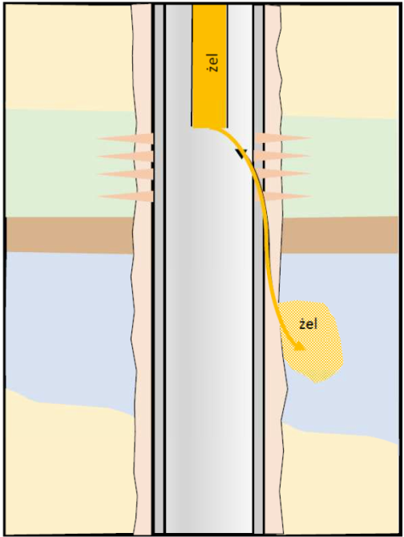
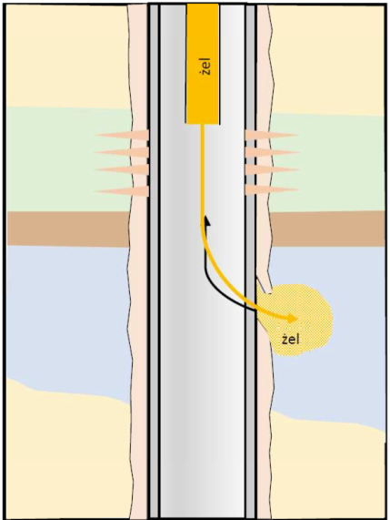
Eliminate flows behind pipes and casing leaks in gas & oils wells
Tests were carried out to verify the suitability of Multizol fluid for eliminating casing leaks and flows behind pipe.
Ttests were carried out on artificially created fractures and Berea Upper Gray cores, showed that the restriction of reservoir water flow primarily occurs in the vicinity of the fracture, rather than within the fracture itself.
For fractures with a width of 1 mm, the loss of permeability was a maximum of 9.1%.
  For the rock matrix (vicinity of the fracture ) the average loss of permeability was 90.8%.
The low viscosity of Multizol and elastic properties of Multizol gels are beneficial from the point of view of the effectiveness of these treatments.
Flows behind pipe
Casing leaks

Slide 14
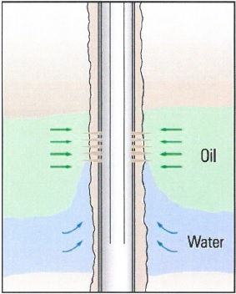
TRIBUTASOL
Technology for restoring gas production
For various reasons, a significant decrease in
gas production may occur after the WSO treatment.
----------------------------------------------------
Then, a production restoration procedure should be performed.
To dissolve the barrier in gas layer you need to have:
TRIBUTASOL treatment fluid
Protocol for the procedure
Gas
Barier
Barier

Slide 15
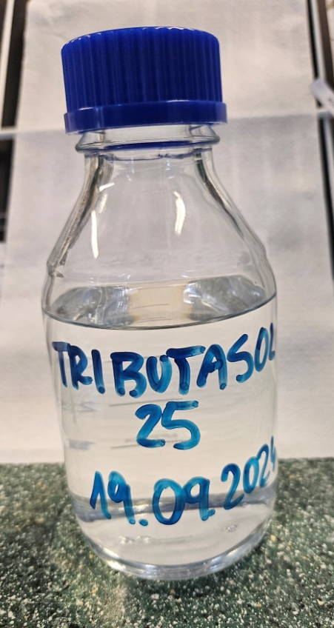
Tributasol-25 reversible fluid
Parameter | Unit | Value
Density at 15°C | kg/m³ | 870,2
Dynamic viscosity (25⁰C) | mPa·s | 1,8
Boiling point of organic part | °C | 80,1
Surface tension | mN/m | 28,3
Selected physicochemical properties of Tributasol-25

Slide 16
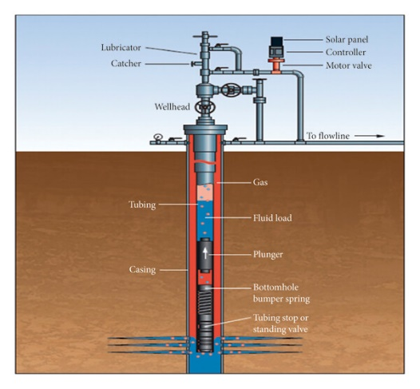
Reversible treatment scenario using Tributasol fluid
Cease gas production.
Using nitrogen, remove formation water from the production column in the perforated zone.
Inject Tributasol-25 fluid into the well at a rate of 25% of the volume of Multizol-35 fluid used.
Shut the well for 24 hours, maintaining pressure approximately 20% above formation pressure.
Resume production, starting with a low rate and then gradually increasing it.
Depending on the results, continue gas production or repeat the Tributasol-25 stimulation treatment.

Slide 17
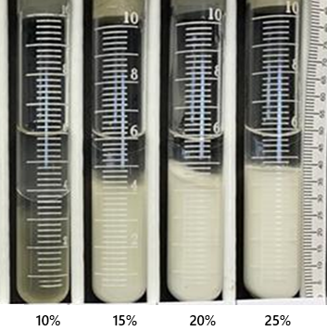
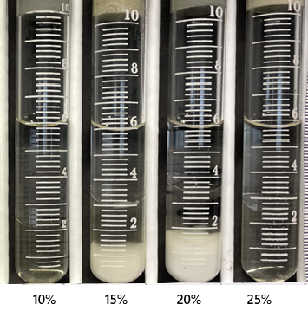
Tributazol – 25 © – reversible fluid
Gel Decomposition
20% Tributazol – 25 Concentration
Reversed on contact
Complete gel bridging removal
Easily applicable
No specialized equipment needed
Tributazol - 25
Multizol - 35
w/o Nanoemulsion
Multizol - 35
o/w Nanoemulsion
Notes:
Add notes

Slide 18
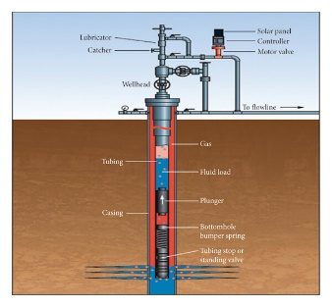
WSO in wells – the essence of Multizol technology
Disadvantage of most chemical WSO technologies:
difficulty in controlling the process (reaction time)
of creating impermeable barriers,
fundamental dependence (in case of RPM) of the treatment's effectiveness on the wettability of rocks,
difficulties in preparing the working fluid on site, i.e. dissolving polymers.
the effects of the treatments are irreversible
The above disadvantages are not present in the technology using the Multizol treatment liquid prepared on the basis of microemulsion.
Notes:
początki technik KPW z cieczą na bazie mikroemulsji to lata 1995-2018 i technologia opracowana na Węgrzech przez prof. Lakatosa i wdrożona na 16 odwiertach
podstawowe ograniczenie technologi Lakatosa to zasolenie wody złożowej max. do 1,5 %

Slide 19
Summary
  The technology of water production control in gas wells based on Multizol-35 fluid is at the technological readiness level TRL-8 and is a comprehensive offer for companies exploiting natural gas, with the limit:
Mineralization of formation water 17%
Deposit temperature 70ºC (158 F)
Porous rocks with permeability up to 500 mD
Using the Multizol-35© working fluid, it is possible to eliminate extra-pipe flows in oil & gas wells.
In case of chemical overdose causing a decline in gas production after using Multizol-35 fluid in the WSO process, there is a production restoration technology based on TRIBUTAZOL reversible fluid.

Slide 20

Multizol© Water Shut-off Technology
Micellar Microemulsion Fluid
CONTACTS
Sławomir Falkowicz, falkowicz@inig.pl
Winicjusz Stanik, stanik@inig.pl

