Slide 1


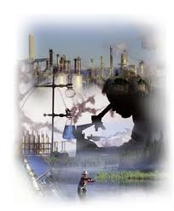




Microbial EOR: Past, Present & Future
Field Insights and Emerging Technologies
Polish Oil & Gas Institute
Tertiary Oil Recovery Program
RAM Biochemicals, Inc.

Slide 2
Microbial EOR: Past, Present & Future
Presentation Outline
What is Microbial EOR?
MEOR Past History – 1926 – 1985
Tertiary Recovery
MEOR Mechanisms
RAM MEOR – 1985 – 1996
RAM MEOR – 2008 – 2010 / DOE-NSWC
RAM History – 2011 – 2022 / MEOR Waterflood
MEOR Process vs MEOR Products
MEOR Products – Dominion Energy Services
Future Insights & Emerging Technologies

Slide 3
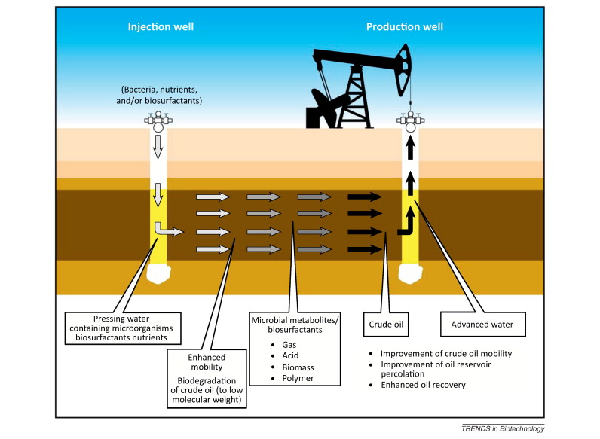
Microbial EOR is Biological EOR = More Oil
MEOR is a TERTIARY biological approach to EOR. But rather than injecting EOR chemicals
or gases, microbes produce them in situ (in the reservoir's oil bearing matrix).

Slide 4
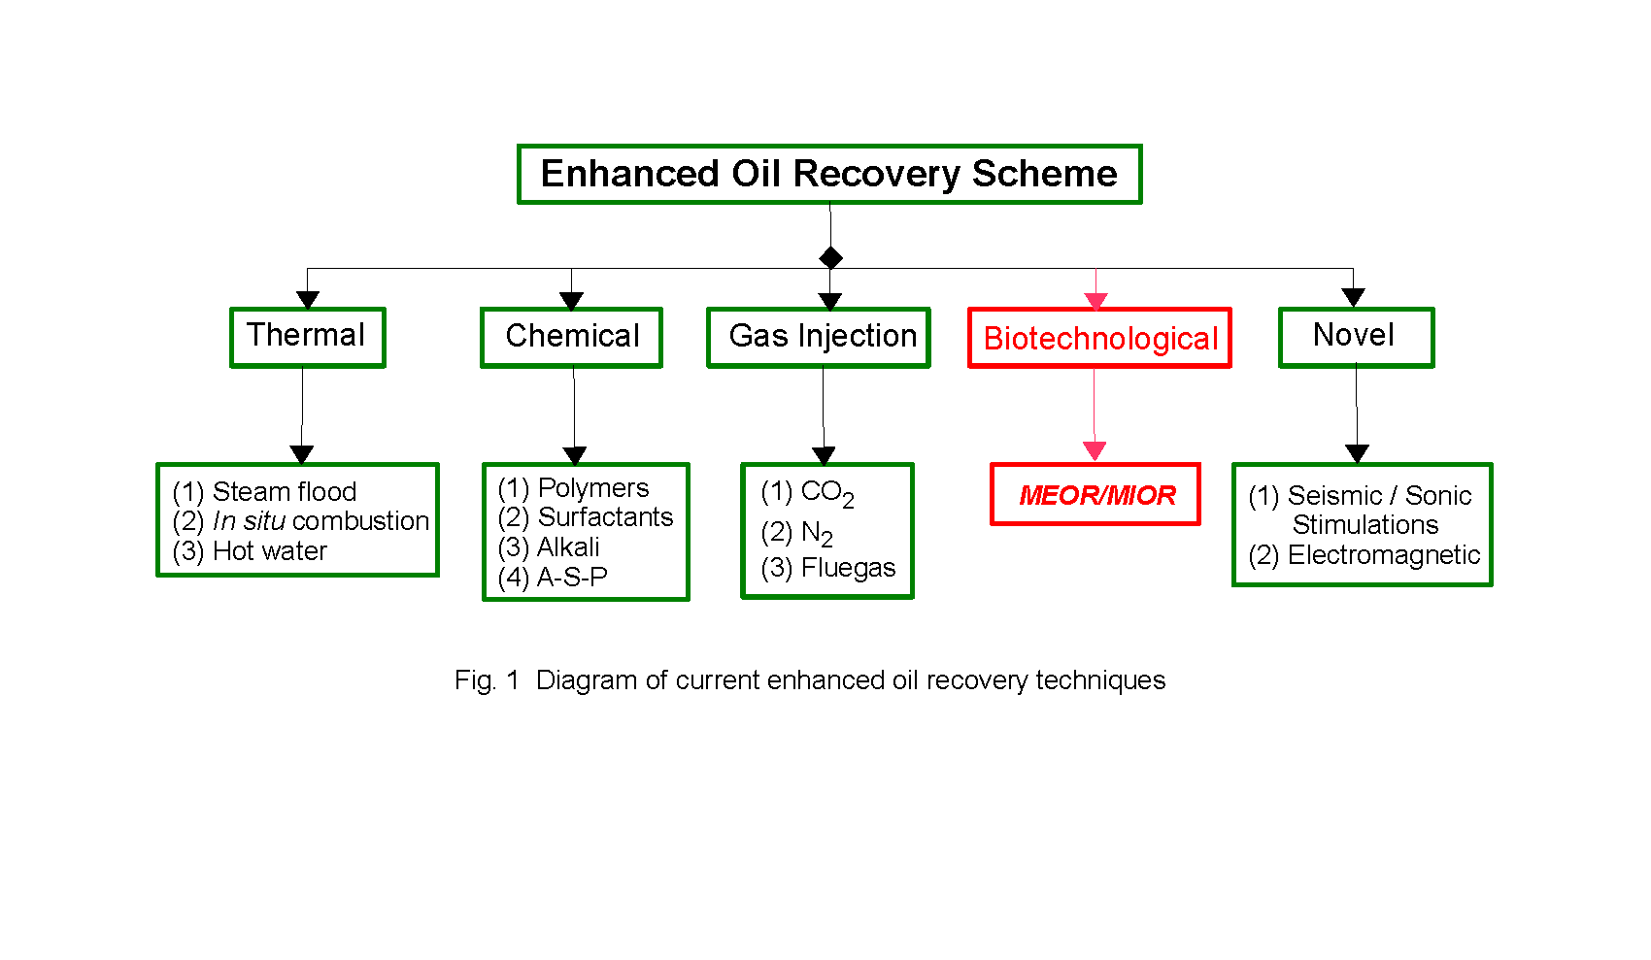
Tertiary Recovery
Tertiary recovery – enhanced oil recovery (EOR) is comprised of a suite of technologies
Tertiary recovery targets remaining 60 to 70% of OOIP still stranded in the reservoir.

Slide 5
MEOR Past History 1926 – 1985
1926-1940s: Conceptualization and Foundational Work
1926: J.W. Beckman Birth of MEOR concept. Beckman suggested microbial activity could mobilize oil properties and generate gases that increase reservoir pressure.
1947: C. ZoBell and colleagues laid the groundwork for petroleum microbiology, with experiments showing the potential for microbial activity to aid in oil recovery
1950-1970s: Basic Research and multiple Field Trials
1954: First U.Ss field trial conducted in Lisbon field, AR with injected microbes and molasses
1957: First patent granted to use injected microbes that produce gases, acids, solvents and bio-surfactants to recover stranded oil.
1958: A method for selective plugging using microbial biomass was proposed
1970-1980: Global interest & research intensified, laboratory to field transition
1974: Large-scale field tests in Siberia using nutrient injection to stimulate indigenous microbes.
1976: U.S. pilot tests in shallow reservoirs (e.g., Oklahoma, Texas) using Bacillus species to produce surfactants and gas.
1978 U.S. researchers (e.g., Bryant, Yarbrough, ZoBell, and Norris) developed mathematical and experimental models of microbial growth and transport in porous media.
1980-1985: Research clarified key mechanisms by which microbes enhance oil recovery:
Gas production (CO₂, CH₄) for re-pressurization.
Bio-acid and solvent formation to improve rock permeability and reduce oil viscosity.
Bio-surfactant production to lower oil–water interfacial tension.
Biopolymer production for selective plugging of high-permeability zones.
Significant research papers on Microbial EOR were published in the mid-1980s by:
W. Finnerty, R.S. Bryant, E.C. Donaldson, J.B. Clark, M.J. McInerney, R.M. Knapp,
G.E. Jenneman, J.E. Zajic, T.F. Yen, E.A. Grula, I. Lazar, B. Bubela and others

Slide 6
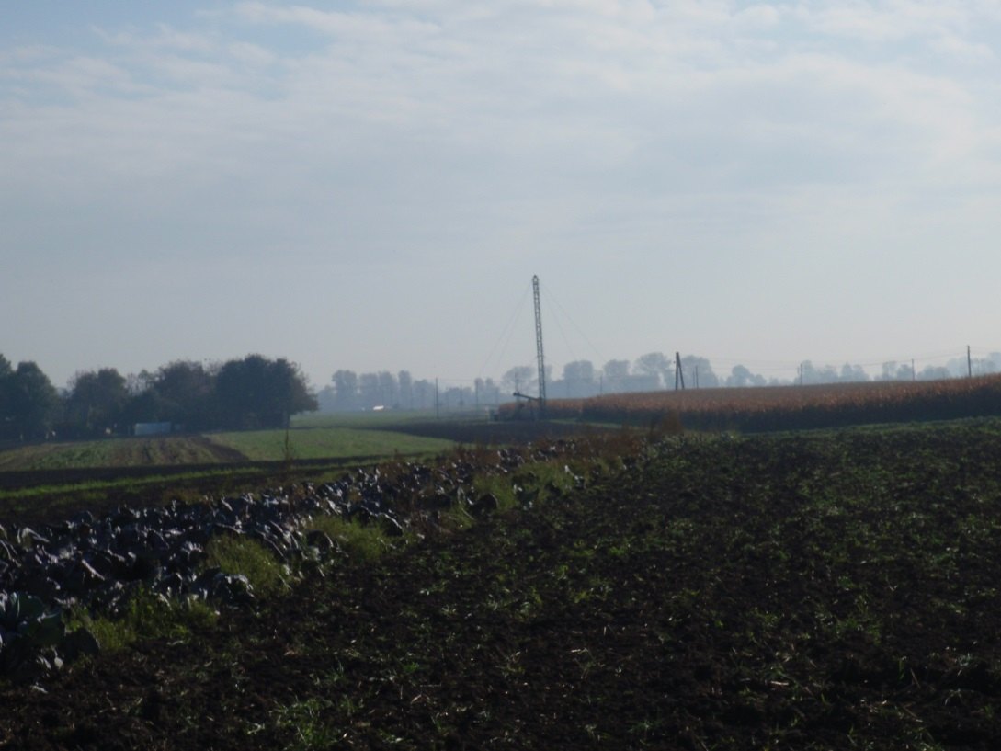


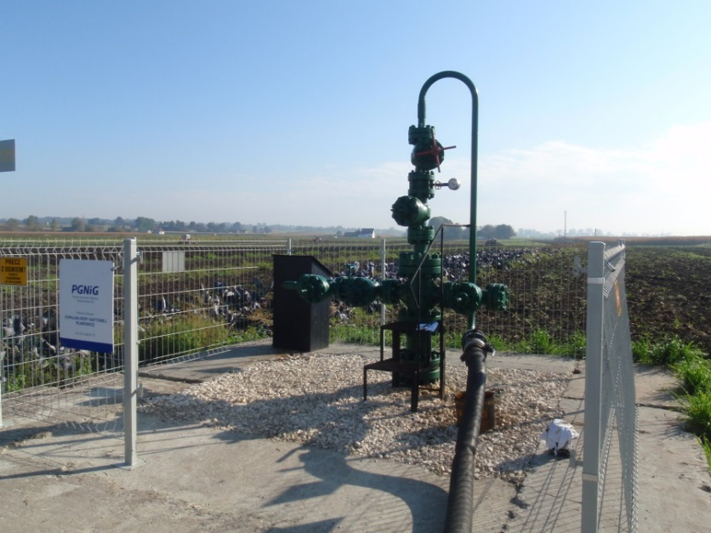

PRODUCER’S LIFE CYCLE
Discovery, Estimation, Development,
Primary recovery`
…doesn’t
Secondary recovery
Battles physics and loses
- poor sweep efficiency
- poor displacement efficiency
Tertiary recovery – MEOR delivers
EOR performance at waterflood cost
Thanks to Dr. Steven Bryant, U. of TX at Austin. Graphics adapted from his SPE Presentation: A Sober Look at MEOR

Slide 7
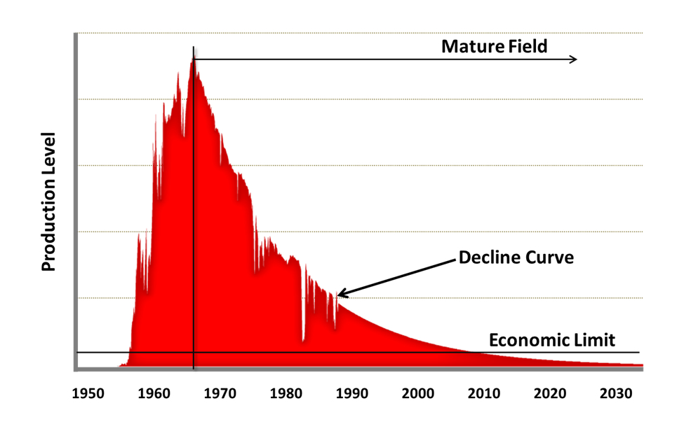
Production Decline = Economic Decline
Oil production is in a constant losing struggle with physics. Water flooding suffers from poor displacement and poor sweep efficiency. The result is declining production that will eventually reach an economic limit.
Microbial Enhanced Waterflooding
Influence on the Decline Curve
Halliburton Mature Fields – production curve
Plawowice Well P-52
24 Month Decline Arrested
60 Months
Production

Slide 8
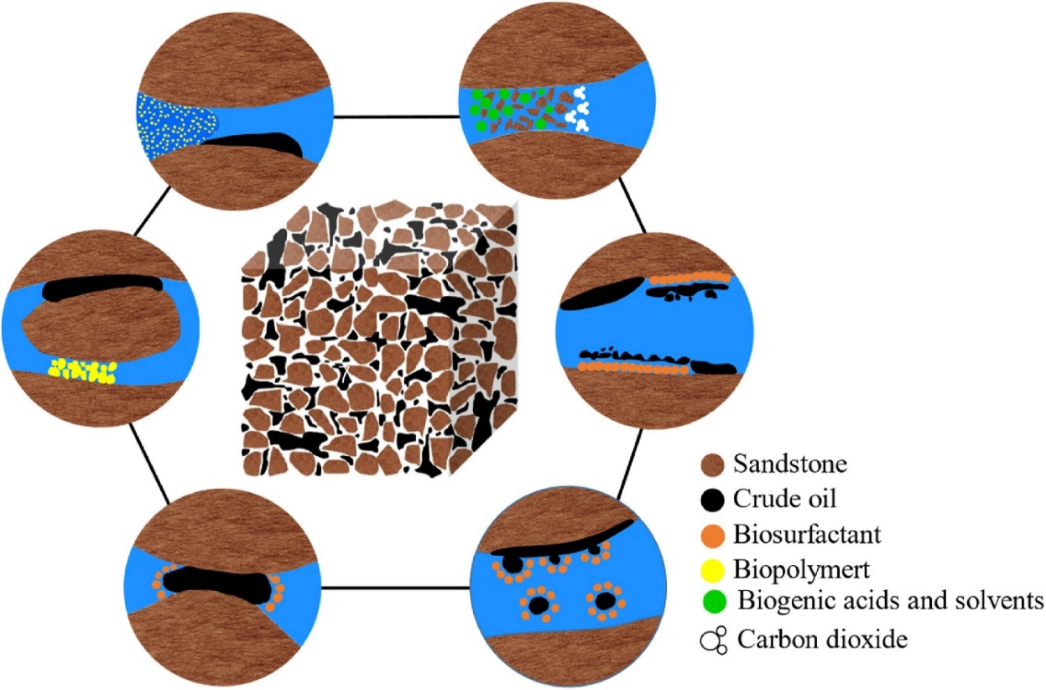
MEOR Mechanisms
(1) Biosurfactants are mainly used to reduce the oil/water interfacial tension, modify the porous media wettability, emulsify residual oil, and improve the migration ability of bacteria
(3) Biogases, solvents and biogenic acids can dissolve the carbonate rocks in oil reservoirs, making it easier for water to enter the pores of rocks and contact with the residual oil. Meanwhile, the gas produced by some of the dissolved carbonate rocks can increase the reservoir pressure
(2) Biopolymers and
microorganisms plug
high-permeability
porous media selectively. Biopolymers are often used as thickeners to increase the viscosity of the aqueous phase and expand the sweep efficiency.
(4) The microorganisms in reservoirs live on the crude oil as carbon source, which can degrade the long-chain saturated hydrocarbons, reducing viscosity and improving the fluidity of crude oil.
MEOR Improves sweep volume and enhances oil displacement efficiency

Slide 9
RAM MEOR History 1985 – 2012
RAM MEOR – 1985 – 1996
RAM Biochemicals began production of Wel-Prep 5™ Oil Recovery Fluid in 1985.
This rich liquid broth was a blend of microbial nutrients and enzymes produced
by fermentation processing. Wel-Prep was developed specifically to stimulate
growth of beneficial microbes already present in oil bearing formations.
Wel-Prep was sold directly to oil producers in TX, IL, KS, OK, AR, and LA.
Partial Listing of Producers
Petroleum Technologies, Inc. | GMO Company, Inc. | Western Engineering
Two Rivers | Razorback Exploration | Eliott Oil Company
Warren & Company | Dean Bach Oil Field Service | American Warrior
PSL, Inc. | Hammersmith | TexLee, Inc.
ADI | L. Jack Gross Production | Starr F. Schlobolm Oil
Marsh Oil & Gas | Ropet, Inc. | Warrior Chemical, Inc.
Clark Oil Company | Criteria Petroleum
Petroleum Technologies, Inc. | GMO Company, Inc. | Western Engineering
Two Rivers | Razorback Exploration | Eliott Oil Company
Warren & Company | Dean Bach Oil Field Service | American Warrior
PSL, Inc. | Hammersmith | TexLee, Inc.
ADI | L. Jack Gross Production | Starr F. Schlobolm Oil
Marsh Oil & Gas | Ropet, Inc. | Warrior Chemical, Inc.
Clark Oil Company | Criteria Petroleum
Product was also sold as an installed service by several oil field service companies.
Between 1985 to 1996 Wel-Prep was used in over 2,200 single well treatments and several small water floods. RAM recommended taking a ‘shot-gun’ approach; treat poorly performing wells twice and evaluate the response. Drop unresponsive wells from the program, and retreated responsive wells at 30 to 60 day intervals. Monitor long-term production performance.

Slide 10
RAM MEOR – 1985 – 1996
Wel-Prep performance from 3 ½ years of regular cyclic well treatments.

Slide 11
RAM History 2008 – 2011 DOE / SWC Grant
MILESTONES
2008 – Applied for DOE / SWC Grant: Reproduce Wel-Prep 5 and evaluate results of field trials.
Validation of Incremental Oil Production in Single Wells and Waterflood
by in situ Stimulation of Indigenous Microorganisms
Grant Awarded, Pilot Plant assembled & treatment fluid processing begins
2009 1st and 2nd batch of oil recovery fluid shipped to KS (20–250 gal totes each batch)
RAM granted a 6-month extension
Field trials by 3 cooperating KS oil producers, data collection
2010 Field trials and data collected continued
Final Topical Report issued August 10, 2020 and posted to RAM Website
Project Assumptions
Beneficial microbes are present in all candidate wells
Injection of bio-available nutrients will increase microbial metabolic activity
Increased metabolic activity will result in additional oil production
Project Results Through the Reporting Period
Single Wells - 45% Measureable gain, 35% No gain, 20% Slight loss
Measureable gain from 1 small waterflood
NOTE: Production data reflected in RAM’s Final Topical Report was less than
4 months; an insufficient time to assess treatment economic or validate
incremental oil increase by stimulation of indigenous organisms

Slide 12
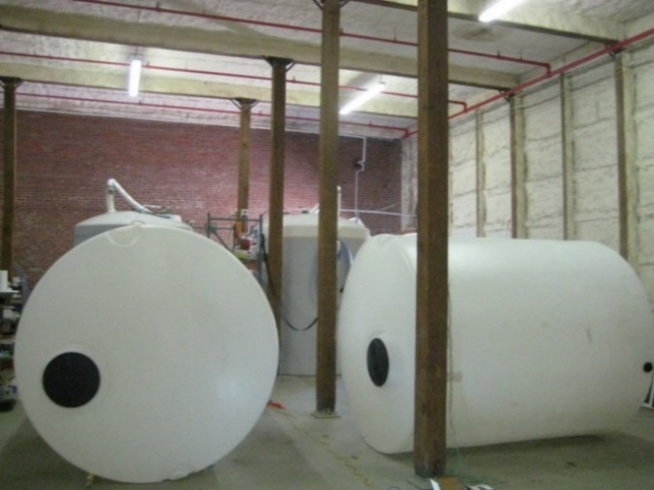
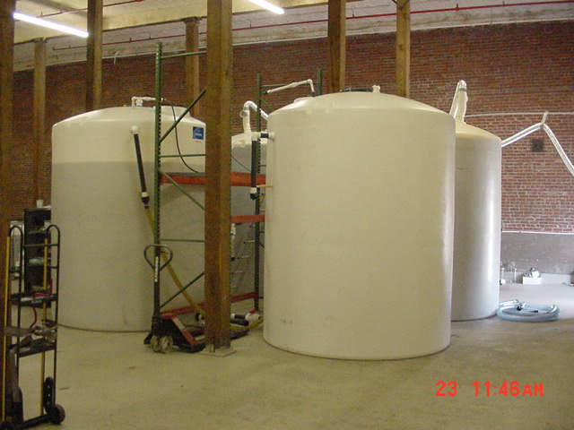
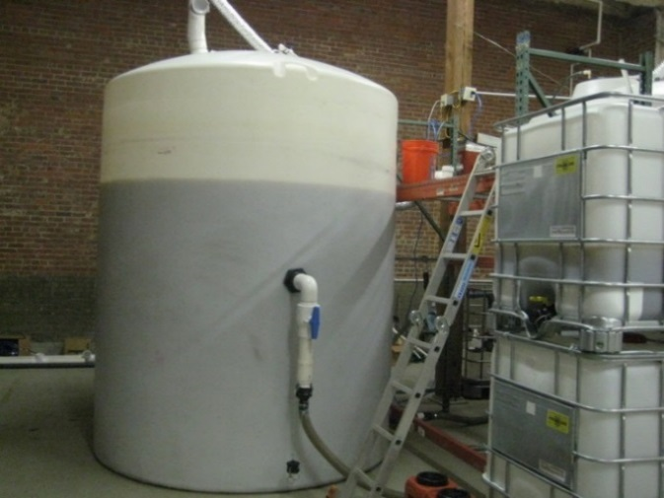
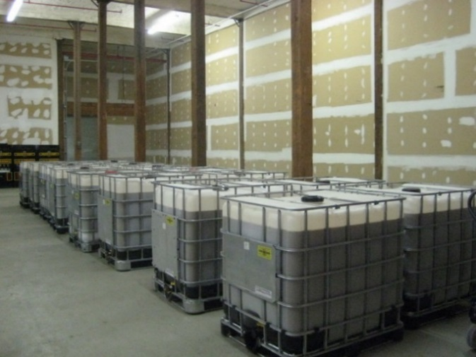
DOE / SWC Project – Oil Recovery Fluid Processing
4 - 3,000 Gallon Poly Tanks Arrive at Pilot Plant
Pilot Plant Tank Configuration
Processing Tank Inoculated From Tote
Treatment Fluid Ready to Ship

Slide 13
Oil Recovery Fluid Properties
Bio-available nutrient formulated to stimulate beneficial microbial populations present in oil-bearing formations
Functional nutrient concentration < 1%
Delivery mechanism - spherical vesicles about < 10 µ
Full strength - properties similar to traditional near wellbore clean-up chemicals;
chelating agent <scale reduction: Ca, Mg, Fe, & Ba>
reducing agent <bio-film - removes oxygen from near wellbore environment>
organic acid - <may be useful in acid fracs / carbonate formations>
surfactant – <emulsification, Pour Point Depression (PPD), crystal modification to reduce paraffin production problems>

Slide 14


RAM MEOR – 2011 - 2022
Plawowice Microbial Assisted Waterflood (MAW)
Project was a collaborative effort between INiG-PIB (Polish Oil & Gas Institute),
RAM Biochemicals & PGNiG (Polish Oil & Gas Company
Project Chronology
2010 – RAM ships INiG-PIB small samples of freeze-dried microbial strains and written protocols for laboratory studies and performance evaluation.
Revival and growth studies under laboratory conditions
Growth studies under simulated reservoir conditions
Core flood testing / Recovery Factor determination under simulated reservoir conditions
Laboratory studies indicate a ‘Go’ for field trials at Plawowice
Delta Viscosity Index (DV) > 0.10 Newtonian Index (NI) > 1.10
EOR Index > 1.15 – Indicating positive test for MEOR Treatability
REF: SPE 53715 and SPE 69652
Phase l – October 2011 to September 2014
Phase ll – September 2014 – June 2017
Phase lll – June 2017 – Dec 2021
Phase lV – Dec 2021 – Oct - 2022

Slide 15
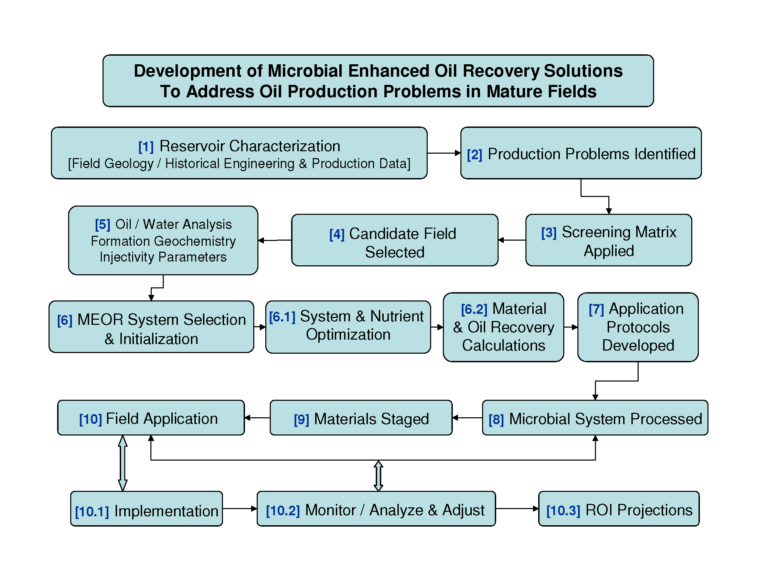
MEOR PROJECT DESIGN & DEVELOPMENT
Paper 2253 • MEOR Field Pilot at Plawowice, Poland
Validation of MEOR for Smaller Scale Projects through
Careful Design, Development, Implementation and Monitoring

Slide 16
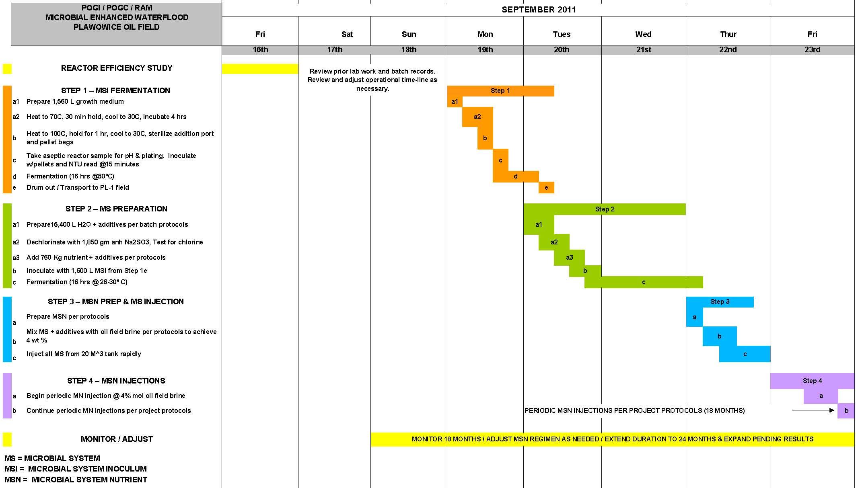
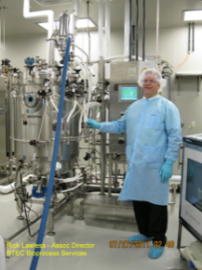
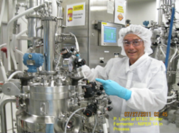
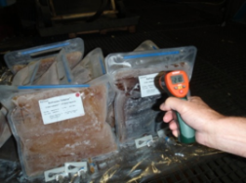
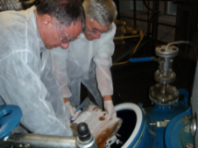
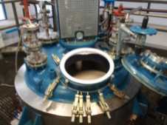
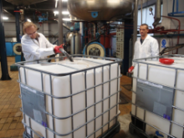
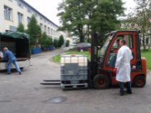
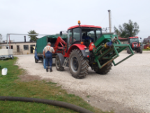
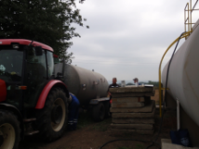
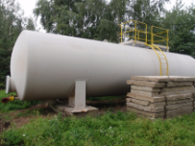
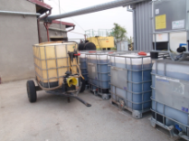
PHASE l – MEOR WATERFLOOD PROJECT PLAN

Slide 17
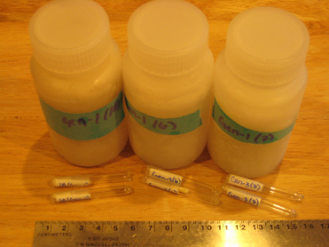
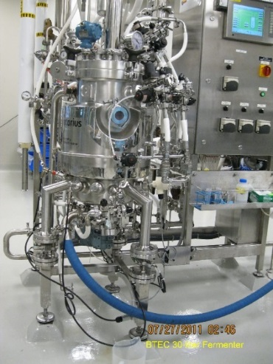

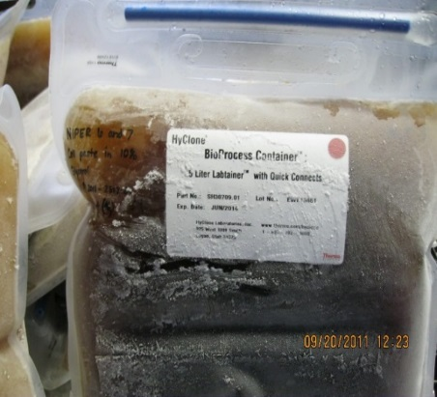
Microbial Assisted Waterflood – Plawowice Oil Field
Laboratory studies give a ‘Go’ for field trials.
Phase I – Scheduled for 12 months, extended to 36 months due to positive performance.
Phase l, ll, & lll Microbial Materials Prepared at NCSU / BTEC
Six 5 ml vials each contain
1 ml lyophilized microbes
Revived and expanded
to 3 - 250 ml bottles of
high CFU microbial broth
BTEC 30 liter
fermentor
BTEC 300 liter fermentor
Frozen pellet bags ≈ 6 kg
Ready to use
Microbial System Inoculum
Shipped to Poland

Slide 18
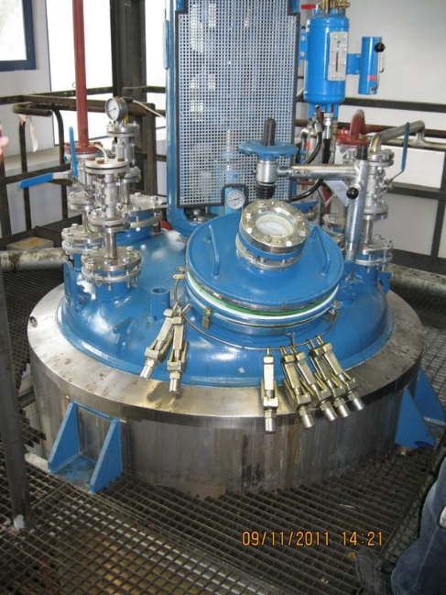
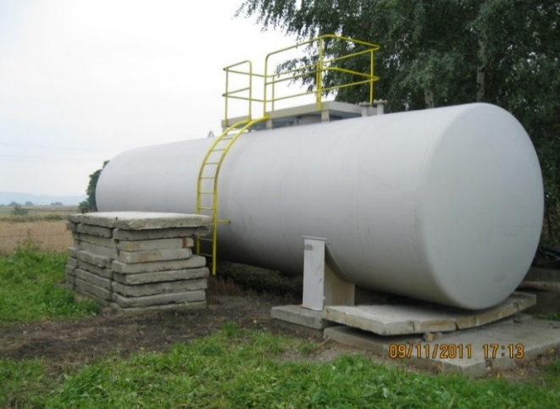
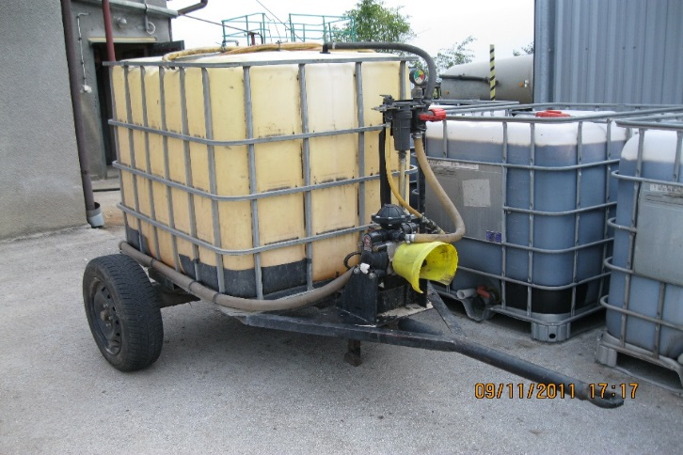
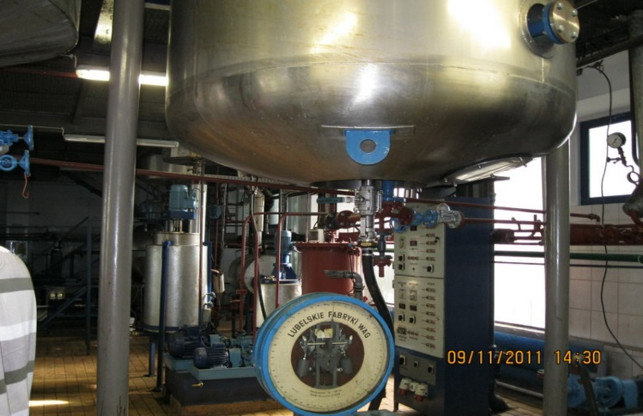
Phase I – Microbial Assisted Waterflood
1:15 Expansion
1,200 Liters MSI
Amplified to
18,000 Liters
Microbial System Treatment Fluid
~ 4,8000 Gallons
Microbial System (MS)
Preparation in Large Tank at
Plawowice Oil Field
Microbial System Inoculum (MSI) 1,200 Liters Prepared in INiG Fermenter, Krakow, Poland
Augmented
MS Nutrient
Injected
Periodically
with Produced
Water @ 2%
W/W
Nutrient Wagon
Plawowice Oil Field

Slide 19
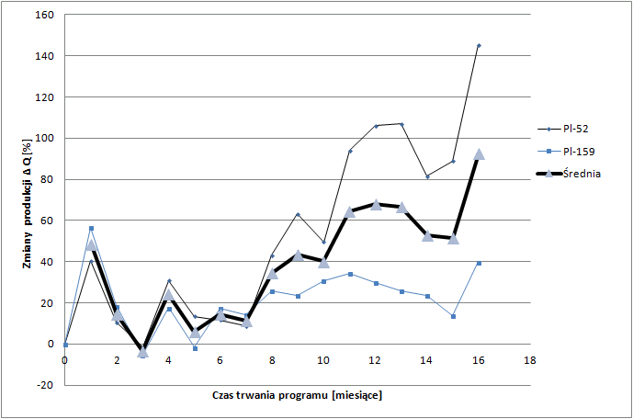
Phase l - Plawowice MAW Results at 16 months
Just over 550 metric tons of oil (3,950 US barrels) were produced at 16 months.
Plawowice project was scheduled to run 18 months, ending by April 2021. But the project was extended to 36 months after a production performance review by the Polish Oil & Gas Company (PGNiG).
Well # | Viscosity Pre-MEOR | Viscosity Post-MEOR | ºAPI Pre-MEOR | ºAPI Post-MEOR | Temperature ºC / F
PL - 52 | 14.74 | 9.52 | 32.5 | 36.0 | 20/68
PL - 159 | 14.96 | 9.79 | 32.5 | 35.9 | 20/68
MEOR’s long-term distinctive response is to Increase net oil rate (RF) and simultaneously reduce Water Cut. This typical duality in MEOR response is explained by a change in apparent oil and water mobilities within the ‘bioreactor’ – the colonized portion of the reservoir.

Slide 20
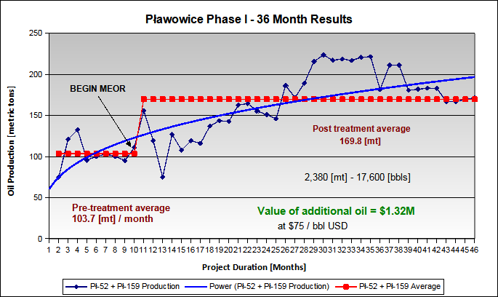
Phase I – Plawowice MAW Results at 36 months
The production spike following initial microbial system [MS] injection is attributed to bio-surfactants produced during final grow-up of the MS slug (±20 mt) which took place at the Plawowice oil field. Injector problems account for the subsequent downturn. Production then trends sharply upwards once the injected MS microbes become established in the formation and begin migrating towards the production wells. Microbial breakout of the injected MS organisms at Pł-159 was observed in the 20th month. Approximately 160 mt of augmented nutrients were periodically injected during the 36 months of Phase l.

Slide 21
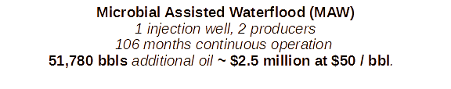
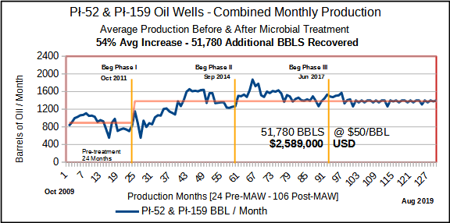
Phase l, lll & lll - Plawowice MAW Results at 106 Months
Plawowice Oil Field is operated by the Polish Oil & Gas Company (PGNiG). The Polish Oil & Gas Institute conducted preliminary laboratory investigations, final microbial system processing and project monitoring. RAM Biochemicals, Inc. participated in project design and development, supplied all microbial materials and protocols for microbial system (MS) processing and field application.

Slide 22
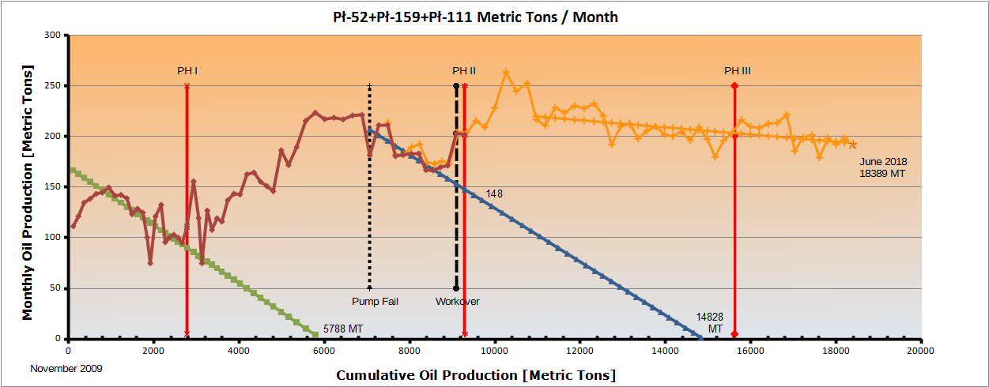
Plawowice Production Life Extended
Phase l protocols required a second microbial system (MS) grow-up in a large tank at the Plawowice oil field. Lessons learned from Phase l allowed RAM to eliminate the large tank and second grow-up by concentrating the (MS) in a single step at INiG’s fermentation facility. This significantly lowered MS treatment volume at each injector, saving PGNiG man hours and reducing injection time without performance loss.
DCA analysis of 24 months cumulative pre-MEOR production (green trend line) predicted exhaustion at 44,000 bbls by month 49. Early Phase l microbial intervention is proof of incremental oil production. When Phase ll started production had already passed the predicted exhaustion point and recovered an additional 4,000 bbls. The Polish Oil & Gas company ordered re-treatments to further extend production life resulting in an additional 51,780 bbls recovered and an improved rate of production through to Phase III at 95 months. Shortly after Phase III started production infrastructure was automated to inject produced water at a steady rate. This stabilized production keeping it well above the pre-treatment average. Production rates remained stable at a higher rate and remained so through the project’s end in December, 2022.

Slide 23
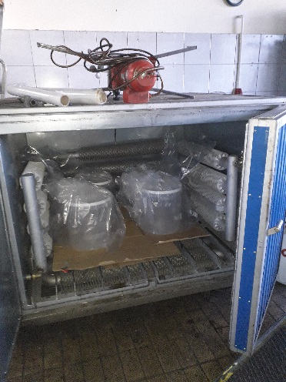
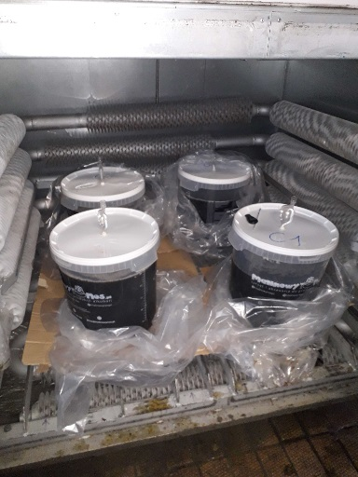
Phase lV Plawowice MAW Materials
15 liters of each strain in amplification high CFU count ≈ 1 x 10⁹ / ml ready to seed INiG’s 1,600 liter reactor prepared with 1,200 liters synthetic brine and nutrients
4 - 250 ml bottles of single strain high CFU microbial broth and nutrient shipped frozen to INiG for Revival and Amplification
15 liters of each strain in incubator after amplification in 20 liter fermenters
Phase lV represents a change in SOP. Unlike the previous three phases where RAM sent INiG ready-to-use mixed Microbial Seed Inoculum (MSI) as large frozen pellet bags, RAM sent small bottles containing concentrated single strains and the provided step-by-step protocols that enabled INiG to prepare a large quantity of Microbial System (MS) treatment fluid in-house.

Slide 24

MEOR PROCESS VS MEOR PRODUCTS
A Step-by-Step process guided all phases of the 10-year Plawowice project. But unlike the first 3 phases where large frozen pellets of ready-to-use Microbial System Inoculum (MSI) were used to produce MS treatment fluid, Phase lV used small pellets of highly concentrated MSI.
By agreement, Phase lV protocols were modified to enable INiG to:
Revive small amounts of microbial seed stock individually in 1-liter flasks under sterile conditions;
Amplify each seed strain to 15 liters in separate 20 L fermenters,
Harvest each strain at their log phase of growth, and
Inoculate 1,200 liters of synthetic growth medium with fresh robust microbial inoculum and produce a sufficient volume of Microbial System for Phase l treatments.
In 2022, RAM and INiG executed a Material and Process Transfer Agreement that enables the Institute to produce microbial treatment fluid in-house for their
clients in Poland and neighboring EU countries using RAM materials and protocols.
While the process implemented in Poland produced excellent results and positive ROI for PGNiG, it required the Institute to ‘produce’ its own microbial treatment fluid. This is not an ideal scenario for independent oil producers. The solution:
Ready to Use Commercially Available Microbial Products

Slide 25



Microbes are the UNCONVENTIONAL SOlution for IMPROVING YOUR PRODUCTION ECONOMICS
Bioactive Services has 30+ years Experience with Microbes
.CONVENTIONAL TREATMENTS
• Acidizing, Solvents, CO₂, Nitrogen, Etc. are Well Known
• Reactions are Complete and “Spent”
CHAINBREAKER MICROBES
• Not as Well Known – A Living Technology
• The Original “Green” Technology - Non-Hazardous
• Highly Concentrated and Stable Formulation
• A Plate Count is Made on Each Production Batch
• Easy to Apply in the Field – No Additional Nutrients
Need to Be Added – Just Hydrate the Concentrate

Slide 26

Microbes are the COST-EFFECTIVE solution for IMPROVING YOUR PRODUCTION ECONOMICS
Bioactive Services has 30+ years Experience with Microbes
CHAINBREAKER MICROBES
• Building and Maintaining a Colony - Concentrated
Dormant Phase is Activated in Water
• The Original Nano-Technology
• 40+ Species in the Formulation
• Shelf Life After Activation is 6 months.
• Non-Hazardous
• Key Application Element – Time
• Addresses a Number of Production Issues

Slide 27
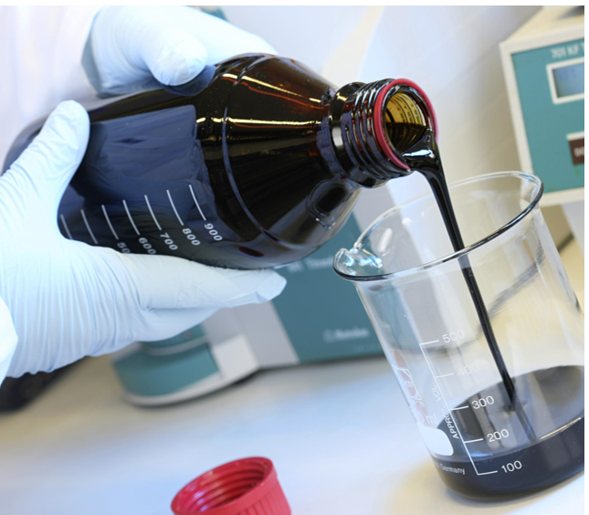


Chainbreaker microbes 4 MAIN functions: • Treat Paraffin and Asphaltenes • Break Emulsions Effectively • Treat Scale • Control Corrosion
Added Benefits Include:
• Control Iron Sulfides
• Control SRBs and H₂S

Slide 28
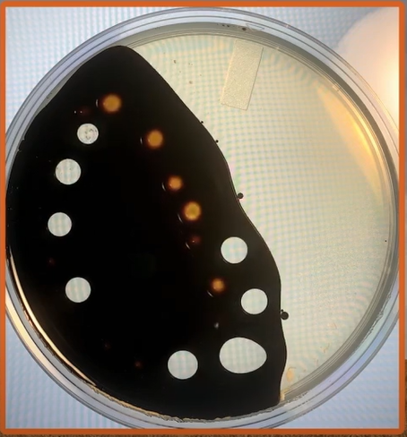

Chainbreaker microbes OPERATING Mechanisms • Degrades the Carbon Chain • Reduces Oil Viscosity • Generates BioGas • Generates BioSurfactants
Encapsulates Within the Cell:
• Calcium
• Sulfur
Sequesters H₂S in the Reservoir!

Slide 29

MULTIPLE chainbreaker APPLICATIONS
• PRODUCTION WELLS
- Vertical
- Horizontal
• WATERFLOODS
• INJECTION WELLS (SWD)
• STORAGE TANKS
• PIPELINES & SURFACE EQUIPMENT

Slide 30
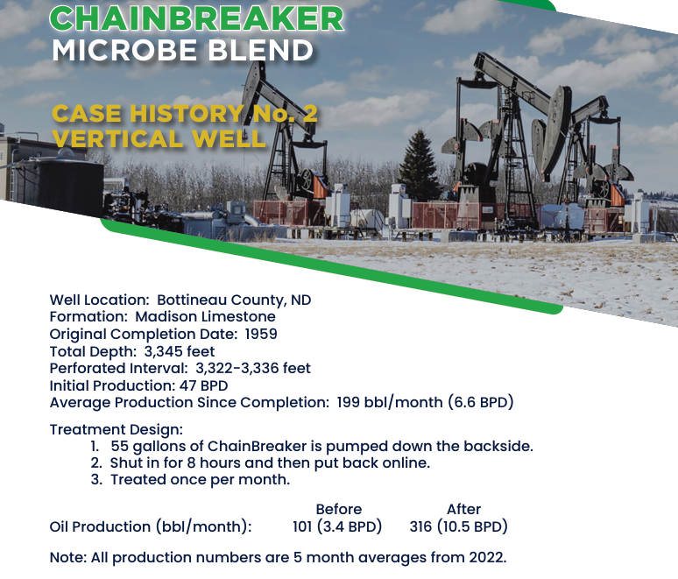

Slide 31
Future Developments & Emerging Technologies Total Lease Management
We expect to see greater acceptance of microbial EOR / IOR technology and greater use of bio-products like biologically produced surfactants, organic acids, enzymes and bio-polymers replacing many traditional production chemicals.
The future for oil & gas production will strongly embrace a Total Lease Management concept that not only looks to improve oil and gas production through sustainable biotechnological mechanisms, but also through use of modern tracer technologies. There is a growing trend to look at lease operations holistically in terms of lease management as means to extend the productive life of oil & gas wells, lower lifting cost and achieve a higher ROI. Also, the use of AI driven tools to manage and monitor production and reporting and careful management of lifting cost will come more and more into play.
The Total Lease Management concept not only looks to improve oil and gas production through sustainable biotechnological mechanisms, but also to utilize emerging technologies to treat produced water for disposal or reuse after valuable strategic materials are recovered. The volume of produced water often increases with reservoir age and proper handling becomes a major operating cost for mature fields. Producers will look to emerging technologies for a solution:
Multizol-35© Microemulsion Fluid to minimize excess water production

Slide 32

INTRODUCING
Multizol-35© Water Shut-off Technology
In Oil & Gas Wells with
Post-treatment Production Stimulation
MULTIZOL-35 - Micellar Microemulsion Fluid

Slide 33
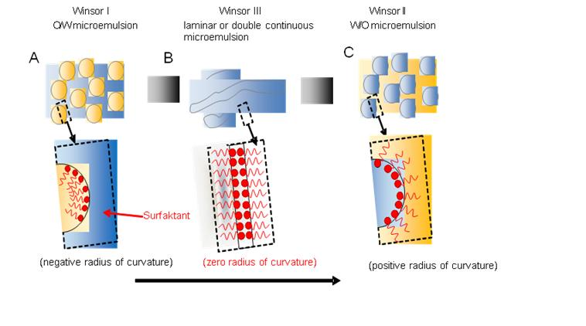
Multizol-35© – Water Shut-Off Fluid Characteristics
Phase transition mechanism
Activated by brine concentration
Rheologically stable fluid system
Validated on over 80 core flow test
Proved in the field conditions
Reversible
Phase transition mechanism
Notes:
Add notes

Slide 34
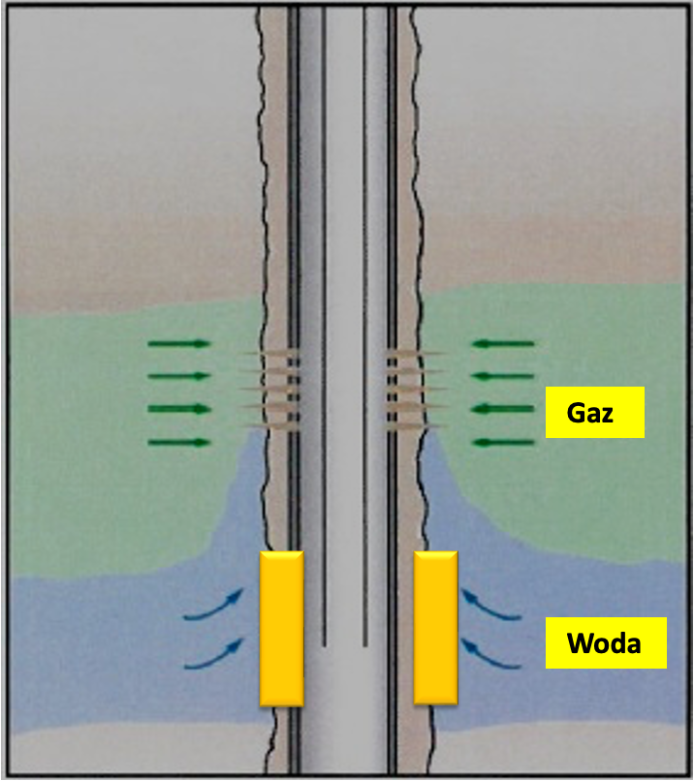
Multizol-35© – Effective System Applications
Insolate water flow from high permeability zones
Mitigate water flow behind the pipe
Block water flow from faults and fractures
Block water incursion from casing leaks
Gas
Water
Water Shut-Off Schematic

Slide 35
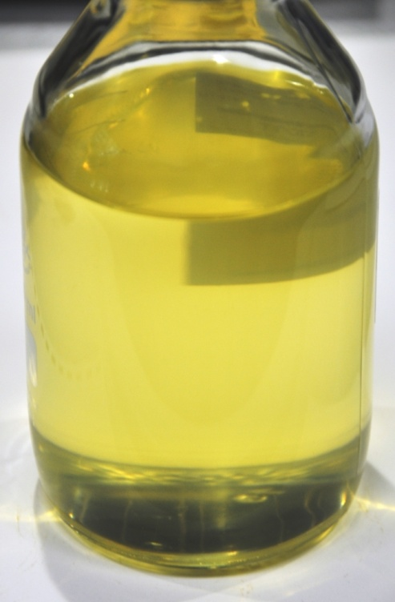
Multizol–35© – Field Application
Application Methods
Nitrogen displacement with Multizol-35 batch
Water displacement with Multizol-35 batch
Natural gas displacement with Multizol-35 batch
Requirements
Displacement of at least 5 ft into the formation
Shut in activation time of 72 hours
Clean fluid for all procedures
Multizol-35
Notes:
Add notes

Slide 36
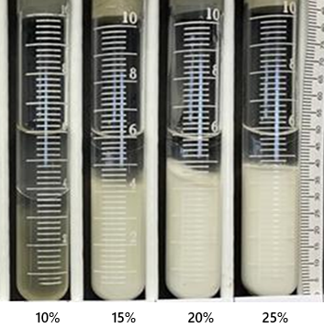
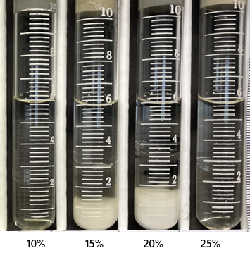
Tributazol – 25 © – reversible fluid
Gel Decomposition
20% Tributazol – 25 Concentration
Reversed on contact
Complete gel bridging removal
Easily applicable
No specialized equipment needed
Tributazol - 25
Multizol - 35
w/o Nanoemulsion
Multizol - 35
o/w Nanoemulsion
Notes:
Add notes

Slide 37
Multizol© Water Shut-off Technology
Micellar Microemulsion Fluid
CONTACTS
Sławomir Falkowicz, falkowicz@inig.pl
Winicjusz Stanik, stanik@inig.pl

Slide 38

Thank you for attending
Microbial EOR Past, Present & Future
A special thanks to TORP and Kansas University
For hosting this video conference
Sławomir Falkowicz, falkowicz@inig.pl
Winicjusz Stanik, stanik@inig.pl
Dominion Energy Services
Michael Walvoord
713-899-2861
mwalvoord@dominionenergyservices.net
www.dominionenergyservices.net
RAM Biochemicals, Inc.
Phillip Launt
806-395-2022
pdlaunt@rambiochemicals.com
www.rambiochemicals.com

