Slide 1


“Challenges for the oil and gas sector in the era of energy transformation"
INTRODUCING
COPELAND HYDROCARBON SURVEY TECHNOLOGY
IDENTIFICATION AND LOCATION OF HYDROCARBON RESOURCES
IN REAL TIME
HydrocarbonSurveys.com
Presented by RAM Biochemicals

Slide 2
PRESENTATION TOPICS
    EQUIPMENT & SOFTWARE
    DATA ACQUISITON
    DATA PRESENTATION – OIL & GAS RESERVOIRS
    WHERE TO DRILL / WHERE NOT TO DRILL
    FAULTS & UNKNOWN CROSS FAULTS FOUND
    OIL FIELD DEVELOPMENT
    EQUIPMENT LEASING & CONSULTING
    SUMMARY
    CONTACT INFORMATION

Slide 3
INTRODUCTION
FIND OIL & GAS with Hydrocarbon Surveys (HS)!
PATENTED COPELAND HYDROCARBON SURVEY SYSTEM OFFERS A NEW, POWERFUL AND INEXPENSIVE ENHANCEMENT TOOL FOR YOUR GEOLOGICAL & GEOPHYSICAL TEAM
HS SYSTEM WILL:
FIND HYDROCARBONS BELOW THE POINT OF MEASUREMENT
FIND LATERAL EXTENT OF RESERVOIRS
GIVE A RELATIVE STRENGTH READING FOR TOTAL HYDROCARBONS CURRENTLY IN PLACE BELOW THE SENSOR
GIVE A DISTINCT READING FOR NON-HYDROCARBON BEARING FAULTS
HS SYSTEM WILL NOT:
TELL HOW MANY PRODUCING ZONES OR FAULTS, HOW DEEP THEY ARE
MEASURE FINITE AMOUNTS OF OIL OR GAS IN PLACE (BBL OIL OR MCFG).
Copeland Hydrocarbon Survey technology granted US Patent #10,761,237 issued September 1, 2020. The Copeland HS System is being used to eliminate dry holes and very low producers, locate in-fill drilling prospects, re-completions and for waterflood design, thus greatly improving a project’s bottom line (HydrocarbonSurveys.com).

Slide 4
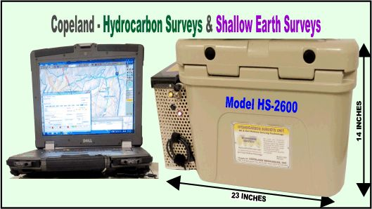
EQUIPMENT & SOFTWARE
Custom Software Preloaded on Laptop
Survey Data From HS-2600 Sent to Laptop & Mapping Program
by Bluetooth®
Cooling System
Maintains 78° F - 25° C ± 0.3° F
Operating Temp Δ 20°
12 VDC System
Flexible Grid Spacing
& real time mapping
GIS Shape File Data
A passive receiver system for Real Time detection of existing hydrocarbons in place, as well as faults, voids, or disturbances directly below each point of measurement.

Slide 5
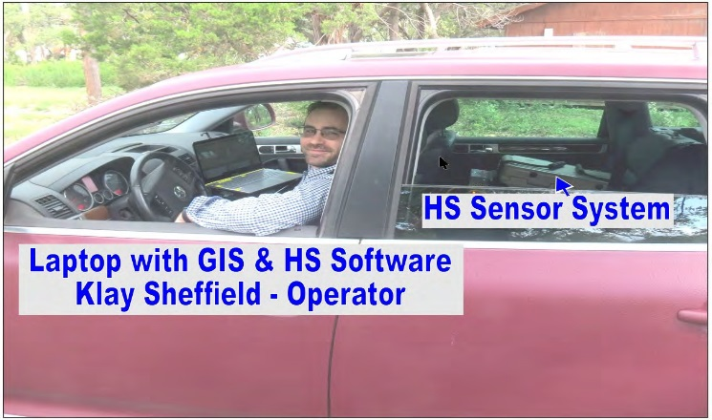
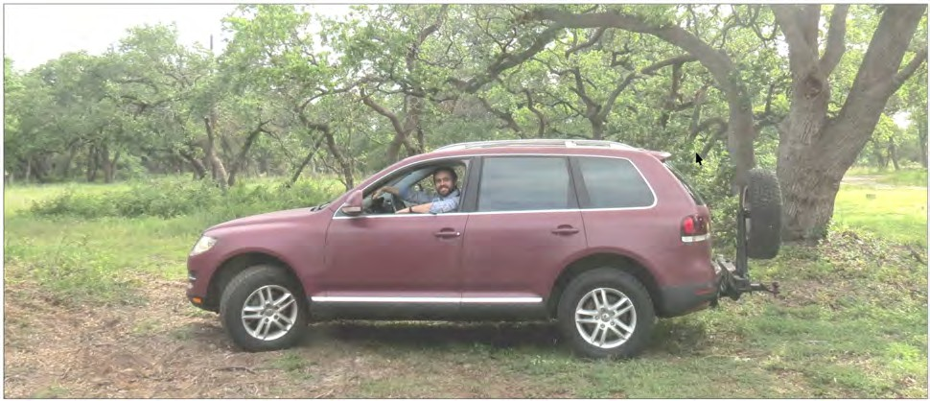
DATA ACQUISITION
DATA ACQUISITION from off-road vehicle: Hydrocarbon readings are gathered in a grid pattern at specified intervals using our proprietary HS software. Since both operator and equipment stay in the vehicle, only 30 seconds are required for each reading. As a result, hundreds of readings can be recorded by each operator in a workday.
Survey data updated after every station reading and exported as GIS shape files. Maps are generated by Copeland proprietary mapping software and delivered to clients in graphical format.

Slide 6
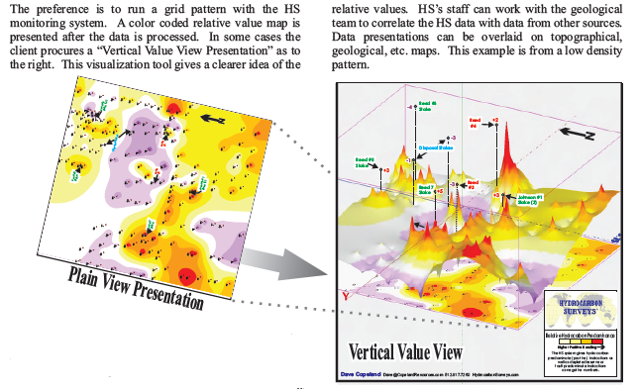
DATA PRESENTATION

Slide 7
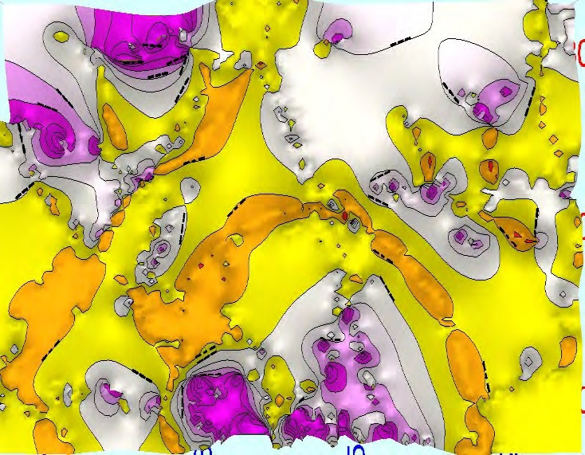

VERTICAL FAULTS & WHERE AND WHERE NOT TO DRILL
1. Locate vertical (Strike-slip) faults and Karst
2. Determine if fault is hydrocarbon bearing, best place drill and where not to drill
3. Point out unstable areas associated with the vertical, strike-slip faults and Karst
Vertical (Strike-slip Fault)
HYDROCARBON PREDOMINANT READINGS
(OIL & GAS)
DRY OR WATER FAULTING
NO HYDROCARBONS (OIL & GAS)
Notes:
Karst is a terrain formed by the dissolution of bedrock, and generally is characterized by sinkholes and caves that channel water underground.

Slide 8
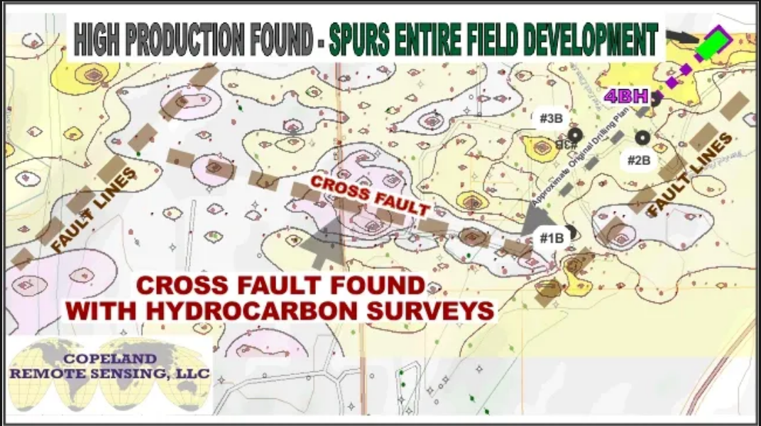
OIL FIELD DEVELOPMENT

Slide 9
EQUIPMENT LEASING AND CONSULTING
Hydrocarbon surveys are conducted on a project-by-project basis. The project’s scope-of-work is developed in consultation with the production company and stakeholders. Once the scope-of-work is agreed to, a written proposal is offered. Upon proposal acceptance by all parties the proposal becomes a formal working contract.
Typical Fees and Charges for Smaller-scale US Projects
HS Equipment - $6,000 US / per *Unit Day / Large Projects per Contract Terms
Equipment Shipping & Insurance – per Contract Terms
Data Processing & Maps - $5,000 – up to 3 Unit Days / Large Projects per Contract Terms
Consulting by Video Conference (Zoom) – 3 hrs per Unit Day Included in Leasing Fee
On-site Consulting and Training if Needed - Travel Expenses + Per Diem per Contract Terms
*1 Unit Day = 24 hours
Note: On-site Consulting and Training is Highly Recommended

Slide 10
SUMMARY
Copeland Hydrocarbon Survey System is a unique, proprietary, and proven oil and gas remote sensing technology that quickly and accurately evaluates the potential of oil & gas projects.
We know of no other remote sensing technology that can match its capabilities to locate oil and gas in real time, eliminate drilling dry holes and very low producers, determine which wells are good candidates for recompletion, and serve as an effective tool for waterflood design and management.
These capabilities provide real value to oil and gas producers by adding to their bottom line.

Slide 11
THANK YOU FOR ATTENDING THIS PRESENTATION
SHOULD YOU NEED ADDITIONAL INFORMATION OR HAVE A SPECIFIC PROJECT TO DISCUSS
HERE IS HOW TO CONTACT US
Copeland Resources Inc.
300 East New Hope Drive, Cedar Park, Texas 78613, United States
Dave@CopelandResources.com
1+ 512-917-7260

